Slide 1


CSCI 132: Basic Data Structures and Algorithms
Course Intro, Syllabus, and Logistics
Reese Pearsall
Spring 2024
https://www.cs.montana.edu/pearsall/classes/spring2024/232/main.html

Slide 2
To start things off, we are going to take a brief look at some of problems we are going to tackle in CSCI 232

Slide 3

Given n houses, where each house has an x,y coordinate, find the pair of houses with the smallest distance between them
(x,y)
(You can assume no houses have the same x or y values)

Slide 4

Given n houses, where each house has an x,y coordinate, find the pair of houses with the smallest distance between them
(x,y)
(You can assume no houses have the same x or y values)

Slide 5
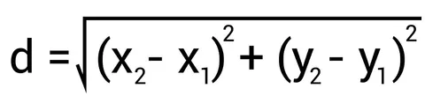
Given n houses, where each house has an x,y coordinate, find the pair of houses with the smallest distance between them
(x,y)
(You can assume no houses have the same x or y values)
Algorithm ?

Slide 6
1
 | H1 | H2 | H3 | … | H9
H1 | / | D(1,2) | D(1,3) | … | D(1,9)
H2 | D(2,1) | / | D(2,3) | … | D(2,9)
H3 | D(3,1) | D(3,2) | / | … | D(3,9)
… | … | … | … | … | ….
H9 | D(9,1) | D(9,2) | D(9,3) | … | /
2
(x,y)
3
4
5
9
Basic solution:
Compute distance for each pair
Select smallest
6
8
7

Slide 7
1
 | H1 | H2 | H3 | … | H9
H1 | / | D(1,2) | D(1,3) | … | D(1,9)
H2 | D(2,1) | / | D(2,3) | … | D(2,9)
H3 | D(3,1) | D(3,2) | / | … | D(3,9)
… | … | … | … | … | ….
H9 | D(9,1) | D(9,2) | D(9,3) | … | /
2
(x,y)
3
4
5
9
Basic solution:
Compute distance for each pair
Select smallest
6
8
7
Running time = ?

Slide 8
1
 | H1 | H2 | H3 | … | H9
H1 | / | D(1,2) | D(1,3) | … | D(1,9)
H2 | D(2,1) | / | D(2,3) | … | D(2,9)
H3 | D(3,1) | D(3,2) | / | … | D(3,9)
… | … | … | … | … | ….
H9 | D(9,1) | D(9,2) | D(9,3) | … | /
2
(x,y)
3
4
5
9
Basic solution:
Compute distance for each pair
Select smallest
6
8
7
Running time = O(n²)
(n = number of houses)

Slide 9
Now things get a bit messier. Our table is going to much larger, and will take more time to compute

Slide 10
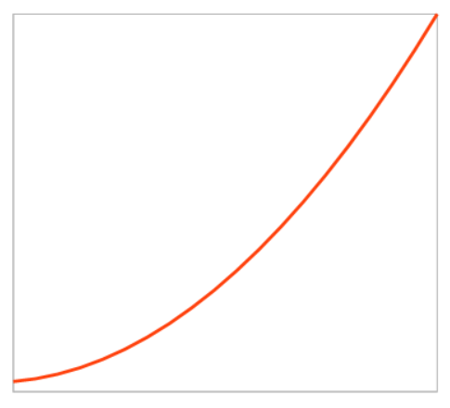
Now things get a bit messier. Our table is going to much larger, and will take more time to compute
Remember, we are concerned with our algorithm performs as some input n grows
Running Time
n

Slide 11
Now things get a bit messier. Our table is going to much larger, and will take more time to compute
Remember, we are concerned with our algorithm performs as some input n grows
Running Time
n
This algorithm does not perform very well as n increases

Slide 12
Now things get a bit messier. Our table is going to much larger, and will take more time to compute
Remember, we are concerned with our algorithm performs as some input n grows
Can we do better?
Running Time
n
This algorithm does not perform very well as n increases

Slide 13
Let’s slightly tweak this problem

Slide 14















Houses are connected through a series of roads, and each road has some distance d

Slide 15

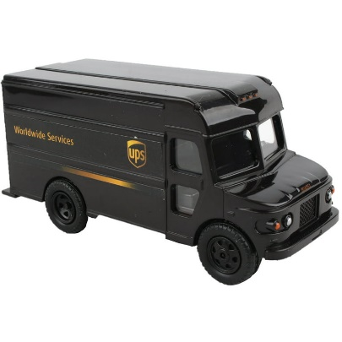















Houses are connected through a series of roads, and each road has some distance d
87
12
1
11
4
9
3
2
25
13
8
3
4
15
3
19
6
16
3
10

Slide 16

Houses are connected through a series of roads, and each road has some distance d
87
12
1
11
4
9
3
UPS person needs to deliver a package to the mansion
2
25
13
8
3
4
15
3
19
6
16
3
10

Slide 17




Houses are connected through a series of roads, and each road has some distance d
87
12
1
11
4
9
3
UPS person needs to deliver a package to the mansion
2
25
13
8
3
4
15
3
Cost: 152
(10 + 19 + 25 + 11 + 87)
19
6
16
3
10

Slide 18




Houses are connected through a series of roads, and each road has some distance d
87
12
1
11
4
9
3
UPS person needs to deliver a package to the mansion
2
25
13
8
3
4
15
3
Cost: 134
(10 + 15 + 13 + 9 + 87)
19
6
16
3
10

Slide 19





Houses are connected through a series of roads, and each road has some distance d
87
12
1
11
4
9
3
UPS person needs to deliver a package to the mansion
2
25
13
8
3
4
15
3
Cost: 131
(10 + 15 + 4 + 6 + 9 + 87)
19
6
16
3
10

Slide 20
Houses are connected through a series of roads, and each road has some distance d
Graph
87
12
1
11
4
9
3
UPS person needs to deliver a package to the mansion
2
25
13
8
3
Goal: Find the shortest path from starting point (red) to ending point (green)
4
15
3
19
6
16
3
10
Algorithm ?

Slide 21
Houses are connected through a series of roads, and each road has some distance d
87
12
1
11
4
9
3
UPS person needs to deliver a package to the mansion
2
25
13
8
3
Goal: Find the shortest path from starting point (red) to ending point (green)
4
15
3
19
6
16
Brute forcing every possible path is not feasible
3
10
(ie exponential or factorial time)

Slide 22
Houses are connected through a series of roads, and each road has some distance d
87
12
1
11
4
9
3
2
25
13
8
3
4
15
3
19
6
16
3
10

Slide 23

The delivery person arrives at the mansion, and notices that nobody is home
87
12
1
11
4
9
3
2
25
13
8
3
4
15
3
19
6
16
3
10

Slide 24
The delivery person arrives at the mansion, and notices that nobody is home
87
12
1
11
4
They decide they are going to rob the house and brings their backpack along
9
3
2
25
13
8
3
4
15
3
19
6
16
3
10

Slide 25
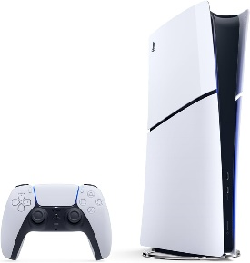





We are going to steal some items from the house and put them into our backpack

Slide 26
Value: 10
Weight: 5
Value: 40
Weight: 4
Value: 30
Weight: 6
Value: 25
Weight: 4
Value: 50
Weight: 3
Value: 5
Weight: 2
We are going to steal some items from the house and put them into our backpack
Each item has a weight, and a value

Slide 27

Value: 10
Weight: 5
Value: 40
Weight: 4
Value: 30
Weight: 6
Value: 25
Weight: 4
Value: 50
Weight: 3
Value: 5
Weight: 2
We are going to steal some items from the house and put them into our backpack
Each item has a weight, and a value
Goal: Steal items such that we maximize the value of items being stole, while not overfilling our backpack
Our backpack can only fill 10 pounds

Slide 28

Value: 10
Weight: 5
Value: 40
Weight: 4
Value: 30
Weight: 6
Value: 25
Weight: 4
Value: 50
Weight: 3
Value: 5
Weight: 2
We are going to steal some items from the house and put them into our backpack
Each item has a weight, and a value
Goal: Steal items such that we maximize the value of items being stole, while not overfilling our backpack
Total Value: 70
Weight: 10

Slide 29
Value: 10
Weight: 5
Value: 40
Weight: 4
Value: 30
Weight: 6
Value: 25
Weight: 4
Value: 50
Weight: 3
Value: 5
Weight: 2
We are going to steal some items from the house and put them into our backpack
Each item has a weight, and a value
Goal: Steal items such that we maximize the value of items being stole, while not overfilling our backpack
Algorithm?

Slide 30
Value: 10
Weight: 5
Value: 40
Weight: 4
Value: 30
Weight: 6
Value: 25
Weight: 4
Value: 50
Weight: 3
Value: 5
Weight: 2
We are going to steal some items from the house and put them into our backpack
Each item has a weight, and a value
Goal: Steal items such that we maximize the value of items being stole, while not overfilling our backpack
Stuff our backpack with the most expensive items until we can’t fit anymore

Slide 31


Value: 10
Weight: 5
Value: 40
Weight: 4
Value: 30
Weight: 6
Value: 25
Weight: 4
Value: 50
Weight: 3
Value: 5
Weight: 2
We are going to steal some items from the house and put them into our backpack
Each item has a weight, and a value
Goal: Steal items such that we maximize the value of items being stole, while not overfilling our backpack
Value: 90
Weight: 9

Slide 32
Value: 10
Weight: 5
Value: 40
Weight: 4
Value: 30
Weight: 6
Value: 25
Weight: 4
Value: 50
Weight: 3
Value: 5
Weight: 2
We are going to steal some items from the house and put them into our backpack
Each item has a weight, and a value
Goal: Steal items such that we maximize the value of items being stole, while not overfilling our backpack
Is this the optimal solution?
Value: 90
Weight: 9

Slide 33
Value: 10
Weight: 5
Value: 40
Weight: 4
Value: 30
Weight: 6
Value: 25
Weight: 4
Value: 50
Weight: 8
Value: 5
Weight: 2
We are going to steal some items from the house and put them into our backpack
Each item has a weight, and a value
Goal: Steal items such that we maximize the value of items being stole, while not overfilling our backpack
Stuff our backpack with the most expensive items until we can’t fit anymore

Slide 34

Value: 10
Weight: 5
Value: 40
Weight: 4
Value: 30
Weight: 6
Value: 25
Weight: 4
Value: 50
Weight: 8
Value: 5
Weight: 2
We are going to steal some items from the house and put them into our backpack
Each item has a weight, and a value
Goal: Steal items such that we maximize the value of items being stole, while not overfilling our backpack
Is this the optimal solution?
Value: 55
Weight: 10
How could we prove our algorithm wrong?

Slide 35
Value: 10
Weight: 5
Value: 40
Weight: 4
Value: 30
Weight: 6
Value: 25
Weight: 4
Value: 50
Weight: 8
Value: 5
Weight: 2
We are going to steal some items from the house and put them into our backpack
Each item has a weight, and a value
Goal: Steal items such that we maximize the value of items being stole, while not overfilling our backpack
Is this the optimal solution?
NO
Value: 55
Weight: 10

Slide 36


Value: 10
Weight: 5
Value: 40
Weight: 4
Value: 30
Weight: 6
Value: 25
Weight: 4
Value: 50
Weight: 8
Value: 5
Weight: 2
We are going to steal some items from the house and put them into our backpack
Each item has a weight, and a value
Goal: Steal items such that we maximize the value of items being stole, while not overfilling our backpack
Our algorithm would never select this solution ☹
Value: 70
Weight: 10

Slide 37
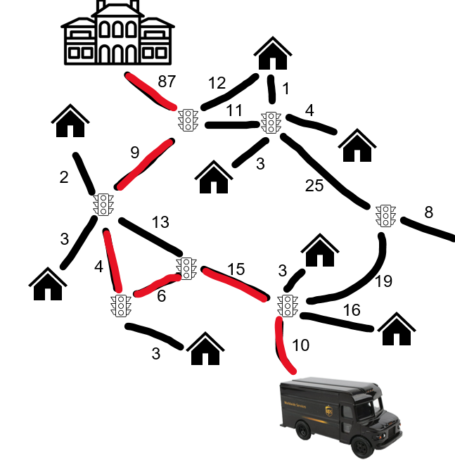
Takeaways:
3
Sometimes the most basic solution is infeasible or inefficient
5
Brute forcing is usually always infeasible for any arbitrary input
Sometimes our proposed algorithm won’t give us the correct answer

Slide 38
Takeaways:
3
We need to produce more creative, efficient algorithms to solve problems
There are many ways to solve a problem, but some ways are better than others
Sometimes the most basic solution is infeasible or inefficient
5
Brute forcing is usually always infeasible for any arbitrary input
Sometimes our algorithm won’t give us the correct answer

Slide 39

Our Goals for this Semester
Code (a lot) (in Java)

Slide 40
Our Goals for this Semester
Code (a lot) (in Java)
Learn about more data structures we can use in our programs (and tradeoffs)

Slide 41
Our Goals for this Semester
Code (a lot) (in Java)
Learn about more data structures we can use in our programs (and tradeoffs)
Learn about more strategies/types of algorithms to solve problems

Slide 42
Our Goals for this Semester
Code (a lot) (in Java)
Learn about more data structures we can use in our programs (and tradeoffs)
Learn about more strategies/types of algorithms to solve problems
Be able to formally detail the performance of an algorithm and identify factors limiting that performance

Slide 43


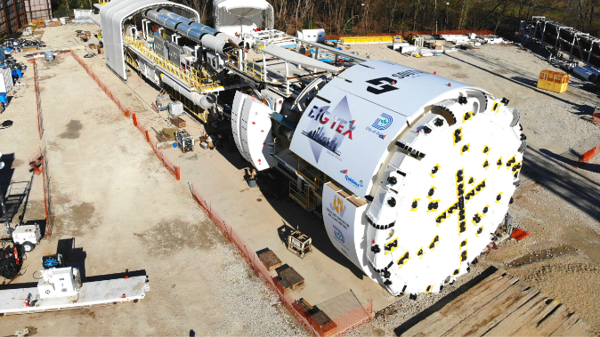
What do you need to dig a hole?
Pros
Cons

Slide 44
What do you need to dig a hole?
Pros
Cons
Cheap
Precise
No Training
Availability
Each tool has their pros, cons, and tradeoffs
Slow
Labor
Fast
Labor
Expensive
Training
Really good at digging
Takes up a lot of garage space

Slide 45
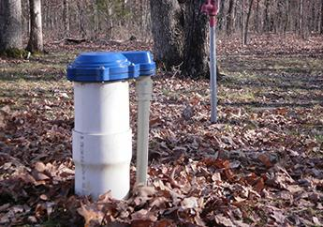
What do you need to dig a hole?
Pros
Cons
Cheap
Precise
No Training
Availability
Best tool for the job?
Slow
Labor
Digging a Well for water
Fast
Labor
Expensive
Training
Really good at digging
Takes up a lot of garage space

Slide 46
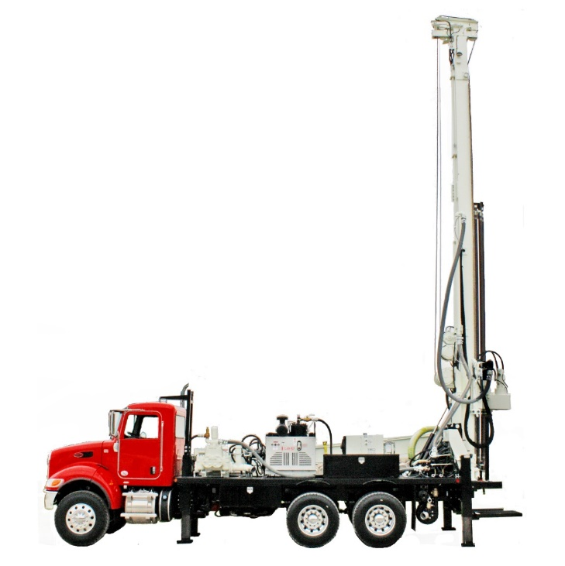
What do you need to dig a hole?
Pros
Cons
Cheap
Precise
No Training
Availability
Best tool for the job?
Slow
Labor
Digging a Well for water
Fast
Labor
Expensive
Training
Really good at digging
Takes up a lot of garage space

Slide 47
What do you need to dig a hole?
Pros
Cons
Cheap
Precise
No Training
Availability
Best tool for the job?
Slow
Labor
Digging a Well for water
We can’t use the best tool for the job unless we know that tool exists!
Fast
Labor
Expensive
Training
Really good at digging
Takes up a lot of garage space

Slide 48
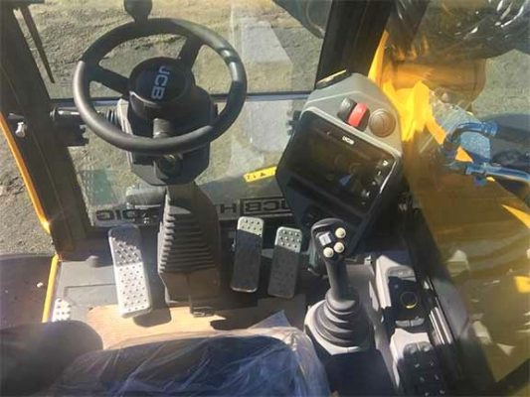
What do you need to dig a hole?
Pros
Cons
Cheap
Precise
No Training
Availability
Slow
Labor
Fast
Labor
Expensive
Training
Really good at digging
Takes up a lot of garage space

Slide 49
What do you need to dig a hole?
Pros
Cons
Cheap
Precise
No Training
Availability
Slow
Labor
Fast
Labor
Expensive
Training
We can’t use the best tool for the job unless we know how to use that tool
Really good at digging
Takes up a lot of garage space

Slide 50


CSCI 232- Data Structures and Algorithms
“Tools”
Arrays
Linked Lists
Stacks/Queues
Hash Tables
Trees
Graphs
“Use of tools”
Sorting
Searching
Routing
Optimization
A data structure is a mechanism for storing and organizing data
An algorithm is a series of instructions to be followed to solve some problem

Slide 51
This class is critical
Learn important set of tools to solve problems
Become autonomous programmers, no more hand holding
All other CS classes build on this*
Job interview questions use stuff from this class

Slide 52
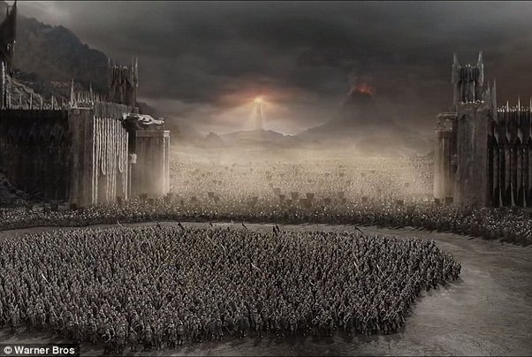
Literally every upper division CS class
CSCI 232
CS students

Slide 53





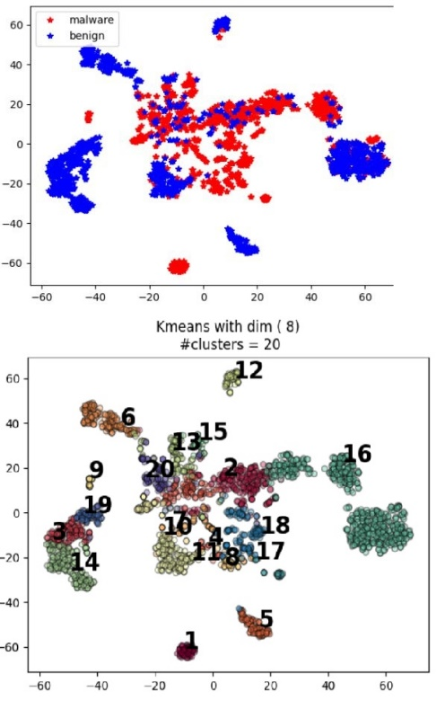
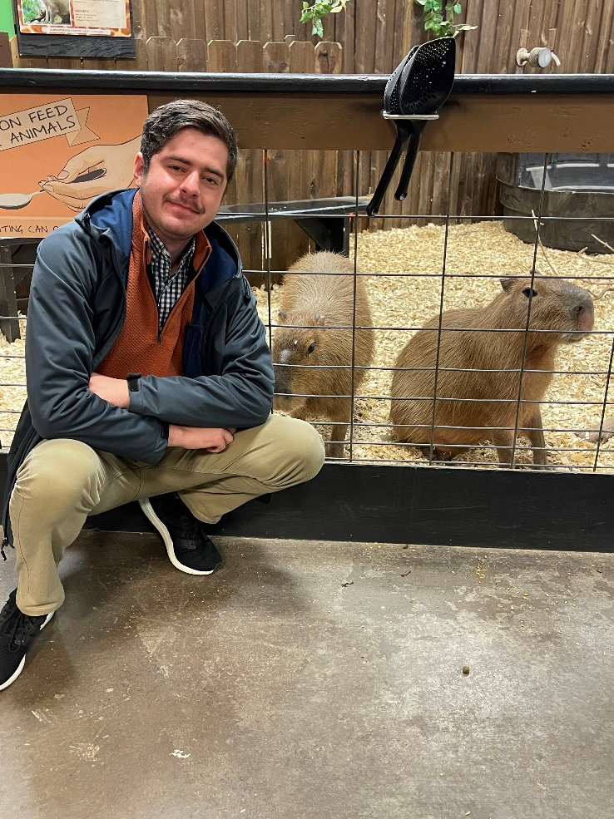
Reese Pearsall
You can just call me “Reese” ☺
(pierce-all)
Second year Instructor @MSU
B.S & M.S @ MSU
Hometown
Billings, MT
Interests
Cybersecurity
Malware analysis and detection
Cybercrime
Computer Science Education
Meatball
Teaching
CSCI 132
CSCI 232
Experience
Software Engineer and Tester, Techlink (Bozeman)
Software Engineer, United States Air Force (Hill AFB, Utah)
Cybersecurity Software Engineer, Hoplite Industries (Bozeman)
Graduate Researcher, MSU (Bozeman)
Outside of academia
Video games, New England Patriots, Fantasy Football, TikTok, Movies, Dr Pepper, Memes, The Bachelor, Naps

Slide 54

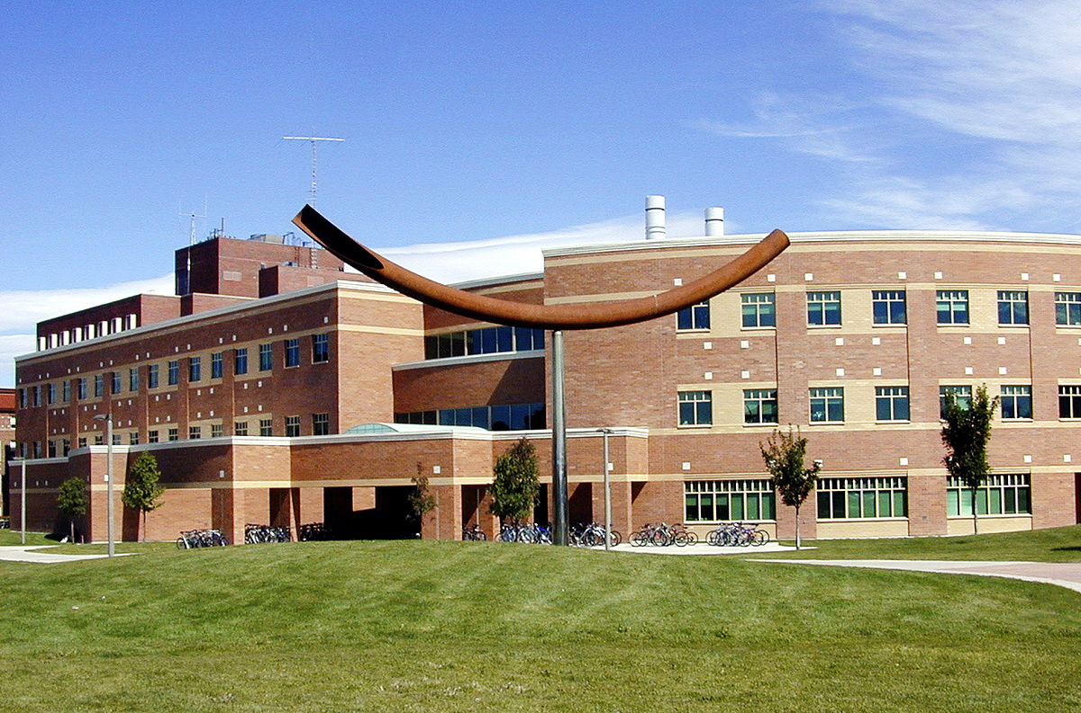
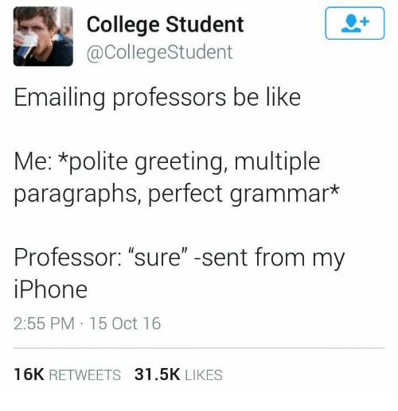


Contact
Email: reese.pearsall@montana.edu (I will respond as soon as I can)
Office Hours: Monday Wednesday 1:00 – 2:00 PM
Tuesday and Friday 12:10 – 1:00 PM
Office: Barnard Hall 361
I am also very responsive on Discord!
(@reese_p)

Slide 55


Course Logistics (Lecture)
Class Meetings
TR: 10:50 AM – 12:05 PM
Barnard Hall 103
All lectures will be recorded and posted on the course website
(coming to class is still a good idea)
We will be doing lots of live coding during lecture, so it might be helpful if you bring your own laptop to class (if you would like to code along)
Please be respectful and considerate of your classmates siting around you

Slide 56
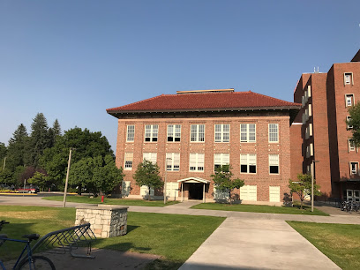

Course Logistics (Lab)
Section 003- Fridays 10:00 - 11:50 AM
Section 004- Fridays 12:00 - 2:00 PM
Section 005- Fridays 2:10 - 4:00 PM
Locations: Roberts 111
You can go to lab and get help from your TA and lab assistants
Lab attendance is optional
Lab assignments will be posted a few days before Fridays and can be completed from home.
You can attend a different lab section earlier/later in the day if you would like

Slide 57
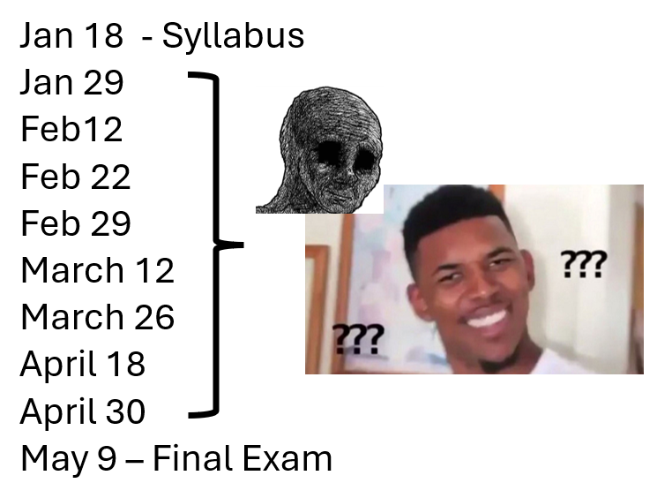
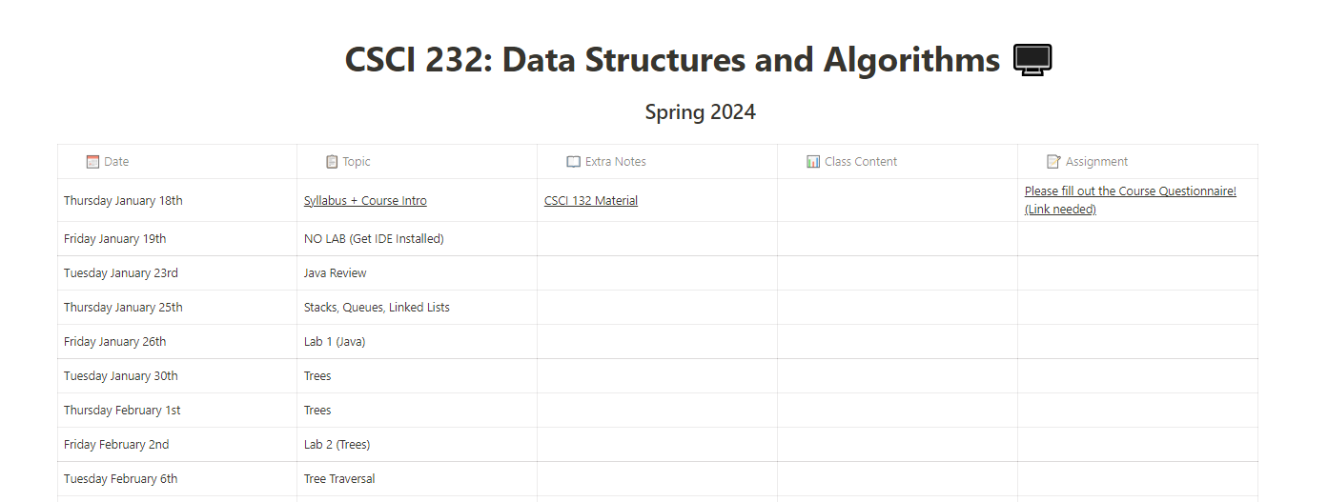

Course Logistics
You will be visiting this website a lot… be sure to bookmark it!
https://www.cs.montana.edu/pearsall/classes/spring2024/232/main.html

Slide 58

Course Logistics
You will be visiting this website a lot… be sure to bookmark it!
https://www.cs.montana.edu/pearsall/classes/spring2024/232/main.html
You also will need to join our Discord server!
(This schedule will change a lot)
Get 232 notifications by typing !join-232

Slide 59
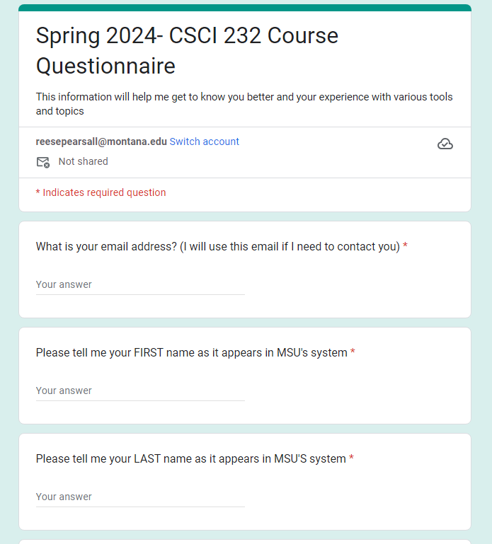

Course Questionnaire
Please take some time this week to fill out the course questionnaire ☺

Slide 60
Prerequisites
CSCI 132- Basic Data Structures and Algorithms (Required)
CSCI 246- Discrete Structures (Recommended)
*You will be totally fine if you have taken 246
Before taking this class, you should feel comfortable basic Java programming, be comfortable using the following data structures: arrays, linked lists, stacks, queues, be comfortable with basic recursion, and how to analyze an algorithm using big-O notation
(If you are not familiar with any of this stuff, you should take some time to review it this week. My CSCI 132 course is available and may be helpful)

Slide 61
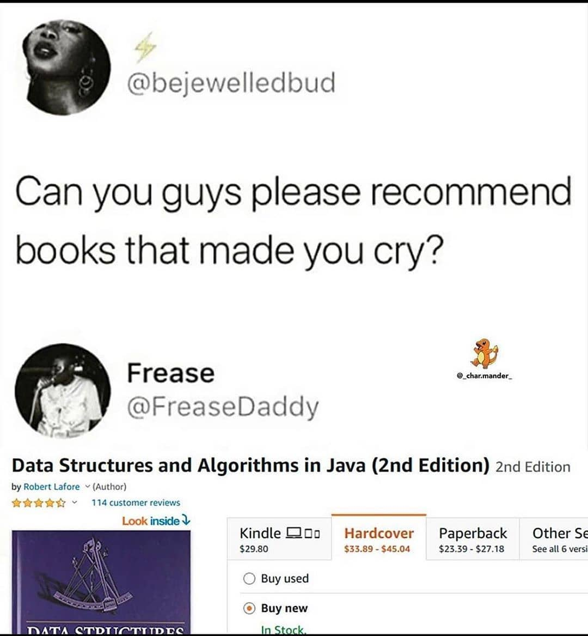
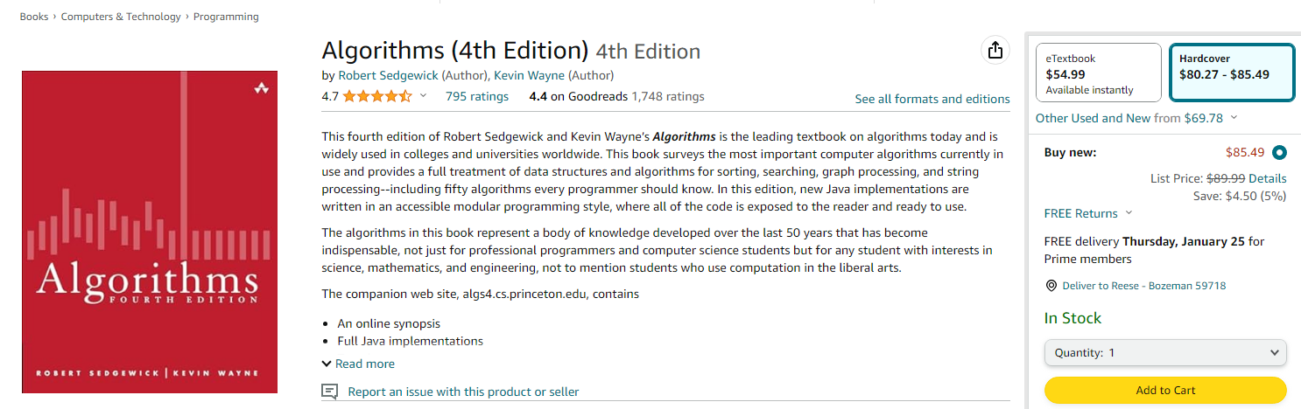
Textbook
(Optional) Algorithms (4th Edition) by Sedgewick and Wayne.
unfortunately, a very relatable meme
This textbook is not required
(but it does have tons of great stuff!!)

Slide 62
Grading
30% - Labs (12 @ ~3% each)
40% - Programs (4 @ 10% each)
15% - Midterm
15% - Final Exam

Slide 63
Grading
Labs (30%)
Shorter, weekly assignments.
Can generally be finished within 1-2.5 hours
Due on Friday nights @ 11:59 PM
I will post the labs a few days ahead of time
You should be able to finish within your 2hr lab time
I will drop your lowest lab grade at the end of the semester
Individual submissions

Slide 64
Grading
Programs (40%)
Longer, more complicated programming assignments
Will likely take 2+ hours to complete
You will always have 2-3 weeks to complete them
Much higher stakes, make sure you give yourself plenty of time to complete them
You can get help from your TA during lab time, or office hours, or from Reese, or on Discord
You are allowed to work with 1 partner

Slide 65
Grading
Exams (Midterm and Final) (30%)
Midterm: Thursday March 21st
Final: Thursday May 9th
Exams consist of short answer, multiple choice, true/false, and some small coding problems
You are allowed to use your laptop and any notes

Slide 66
Grading Deductions
If you submit late, but you are within < 24 of the original. You will face a -25% penalty
If you submit late, but you are within < 48 of the original. You will face a -50% penalty
Any assignment submitted 48+ hours after the deadline will not be accepted
You must submit code that compiles. Code that does not compile will receive an automatic 0%.
If your code compiles and runs, but doesn’t work, or has runtime errors later on, that is ok.
Your TA or I should not need to fix your code in order for it to compile and run

Slide 67
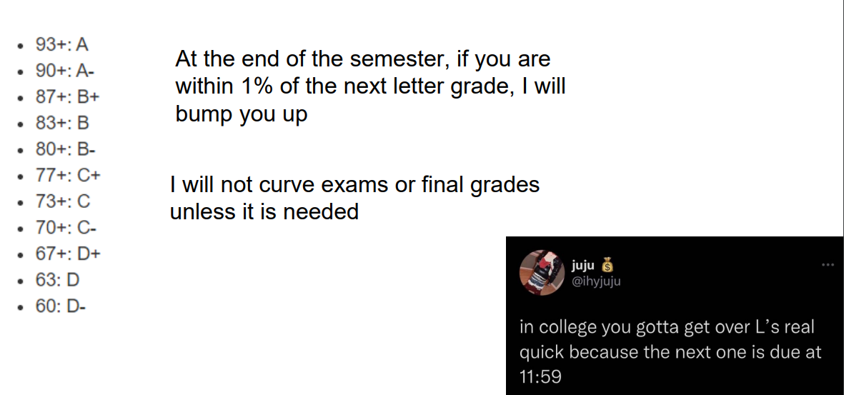
Grading Scale

Slide 68
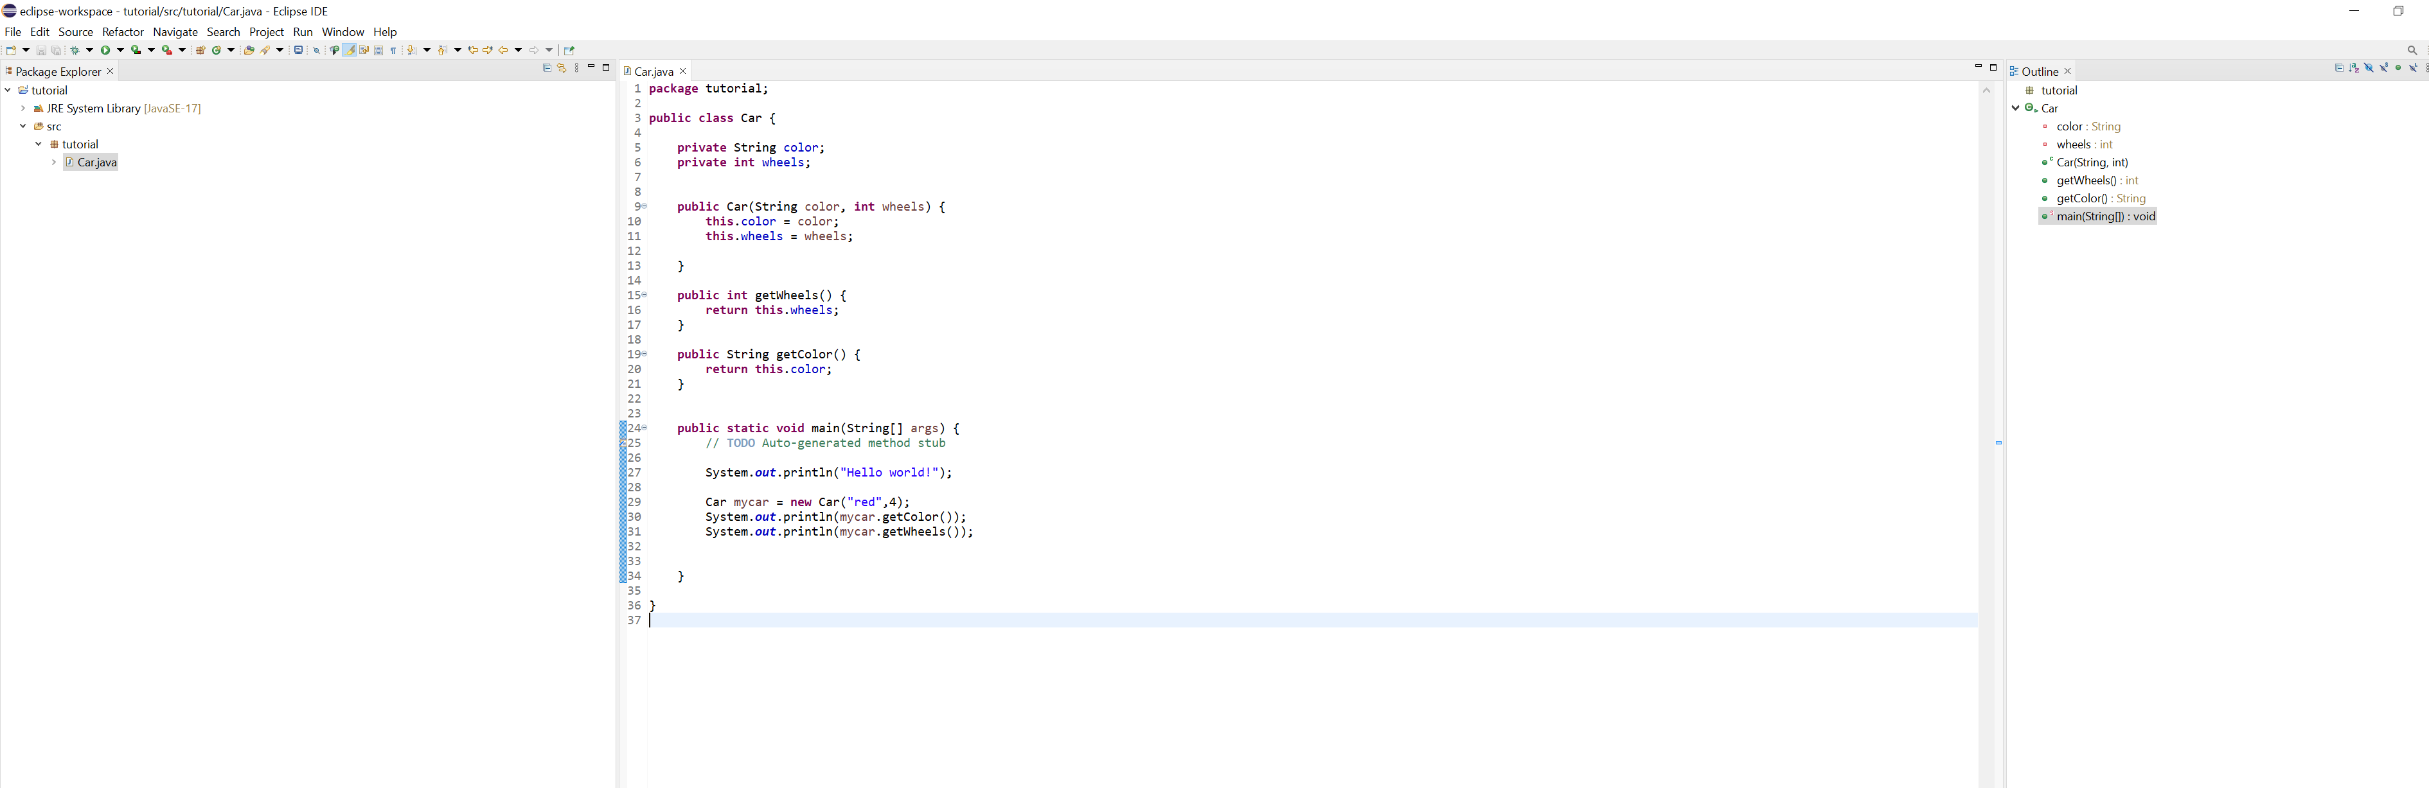
IDE
You will need to download an IDE that you can write Java programs in
Eclipse (I will use this one)
Netbeans
IntelliJ

Slide 69
Academic Misconduct
Plagiarism and cheating is very not cool
You are not allowed to submit something that is not your own, and you are not allowed to steal solutions from another person and modify it
I have a Chegg and Course Hero membership. Don’t try it
Using small snippets of code from the internet is acceptable (but should not be needed). If you do use a small snippet of code from the internet, you should leave a reference as a comment in your code
Do not use any tools or AI that will write code for you

Slide 70

Collaboration Policy
All labs will be individual submissions.
For programs, you are allowed to work with one partner.
When it comes to labs, you may
Share ideas with other students in the class.
Work together on labs in the same physical location.
Help other students troubleshoot problems.
Give hints or provide textbook page numbers/slide numbers to students seeking help
You may NOT
Share your code and solutions directly with other students.
Submit solutions that you did not write.
Modify another student's solution and claim it as your own.
Share your report or solutions directly on Discord

Slide 71


Additional MSU Resources:
https://www.cs.montana.edu/pearsall/classes/msu_resources.html
“Not everyone can become a great artist, but a great artist can come from anywhere”

Slide 72
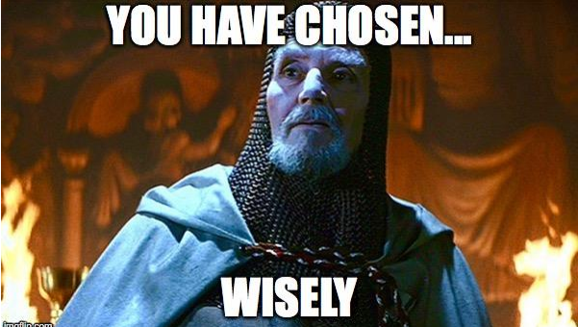
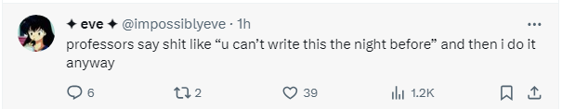

How to do well in this class
Get help when you need it
Get started on assignments early (especially programs)!
Come to class and office hours
Take care of yourself

Slide 73
How to do well in this class
Get help when you need it
Get started on assignments early (especially programs)!
Come to class and office hours
Take care of yourself
Try to have fun
I am here for you, and I am willing to do whatever it takes to help you succeed!

Slide 74

Questions?

